Slide 1

AtliQ Mart
Analysis Report

Slide 2

Contents:
Introduction
At a Glance
Order wise Analysis
Customer wise Analysis

Slide 3
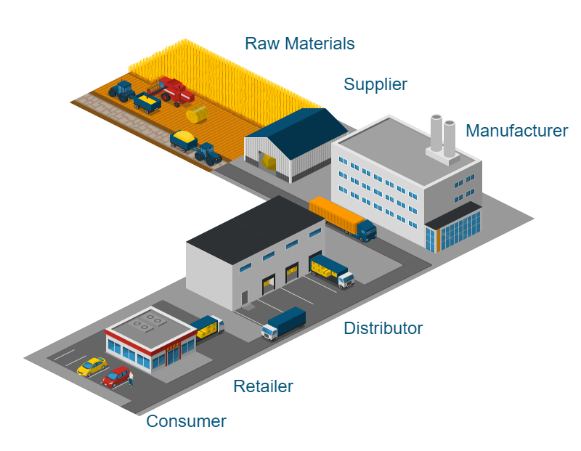
Introduction
AtliQ Mart is a growing FMCG manufacturer, headquartered in Gujarat, India. It is currently operational in three cities Surat, Ahmedabad and Vadodara.
AtliQ Mart is currently facing a problem where a few key customers did not extend their annual contracts due to service issues. This reports helps to better clarity to understand why customer did not extend their annual contract.

Slide 4
At a Glance:
Avg. COCT
Key Matrix
LIFR % (Line Fill Rate): how many orders are fulfilled/delivered among total ordered.
VOFR % (Volume Fill Rate): how many quantity of orders are delivered among total ordered quantity.
OT % (On Time): how many orders are delivered on time.
IF % (In Full): how many orders are delivered in full quantity.
OTIF % (On Time In Full): how many orders are delivered on time and in full quantity.
COCT (Customs Order Cycle Time): how many days take to delivery the order when order was placed.
2.42
Avg. Delay
0.42
VOFR %
99.59 %
Delivered Quantity
Undelivered Quantity
12.97M
457.8k
Ordered Quantity
13.43M
LIFR %
66.02 %
Order Lines
57k
48 %
OTIF %
OTIF % Target
66 %
OT %
69 %
86 %
OT % Target
66.02 %
IF %
IF % Target
77 %

Slide 5
At a Glance:
Insights:
In every month, On Time In Full Delivery Rate (OTIF %) is less than 50%. And in May month OTIF % is lowest.
In August, On Time Delivery Rate(OT %) is lowest, i.e.: 69.53%.
In May, In Full Delivery Rate (IF %) is lowest, i.e.: 66.09%.
In June, Line Fill Rate (LIFR %) is lowest i.e.: 65.44%.
Volume Fill Rate (VIFR %) is almost same in all the months, i.e.: 96.5%.
Feedback:
So, basically you need to improve your overall services like: OT, LIFR, OTIF, etc.
69.6 %
69.07 %
68.57 %
68.63 %
69.41 %
68.53 %
48.72 %
47.82 %
47.81 %
47.93 %
48.64 %
47.94 %
Mar
Apr
May
Jun
Jul
Aug
Mar
Apr
May
Jun
Jul
Aug
OT %
OTIF %
66.35 %
65.94 %
66.09 %
65.44 %
65.83 %
66.5 %
66.35 %
65.94 %
66.09 %
65.44 %
65.83 %
66.45 %
Mar
Apr
May
Jun
Jul
Aug
Mar
Apr
May
Jun
Jul
Aug
LIFR %
IF %

Slide 6
At a Glance:
Customer Name | LIFR %
Coolblue | 51.1%
Info Stores | 52.4%
Sorefoz Mart | 53.3%
Elite Mart | 53.4%
Acclaimed Stores | 59.1%
Vijay Stores | 59.2%
Insights:
Line Fill Rate (LIFR %) is less than 60% in those Customers ( Coolblue, Info Stores, Sorefoz Mart, Elite Mart, Acclaimed Stores, Vijay Stores, etc.).
On Time In Full Delivery (OTIF %) is as lowest as possible in those Customers (Coolblue, Acclaimed Stores, Lotus Mart, etc.).
Feedback:
So, basically you need to focus Coolblue, Acclaimed Stores & Lotus Mart customers to improve the ONIF % and also improve LIFR %.
Customer Name | OTIF %
Coolblue | 13.45%
Acclaimed Stores | 15.43%
Lotus Mart | 16.04%

Slide 7
Order wise Analysis:
27k
Insights:
On Time In Full Delivery is less than 50%, mans, 27k orders are delivered on time in full quantity among 57k orders.
On Time Delivery is almost 72%, means 41k orders are delivered on time among 57k orders.
In Full Delivery is almost 67%, means 38k orders are delivered in full quantity.
In month of March & May orders are 9.76k but in August month your orders is less compare to others months.
Feedback:
So, you need to improve the services like On Time In Full, On Time & In Full Delivery for getting better orders from your customers.
OTIF
IF
38k
41k
OT
57k
Order Lines
9.8k
9.76k
9.76k
9.7k
9.69k
9.6k
9.5k
9.4k
9.4k
9.3k
9.39k
9.2k
9.11k
9.1k
May
June
July
Aug
Mar
Apr
May
June
July
Mar
Apr
Monthly Orders Trend

Slide 8
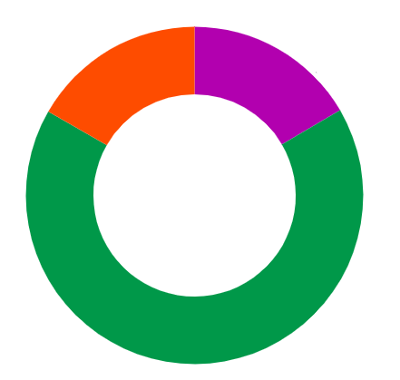
Order wise Analysis:
Insights:
Diary products are ordered most, i.e.: 62%.
Food products are ordered 16.7%.
Beverage products are ordered 16.57%.
Three cities are ordered almost same over the total order lines. Surat 31.2%, Vadodara 34.38% and Ahmedabad 34.5%.
Feedback:
So, you need to focus all the three cities to get more orders and improve the products or add some products under product categories.
Food
16.71%
Diary
66.72%
Beverage
16.57%
Order Lines % by Product Categories
Surat
31.2%
Vadodara
34.38%
Ahmedabad
34.5%
Total Order Lines
57k
City wise Orders

Slide 9
Customer wise Analysis:
Customer Name | OTIF %
Coolblue | 13.45%
Acclaimed Stores | 15.43%
Lotus Mart | 16.04%
Insights:
On Time In Full Delivery (OTIF %) is as lowest as possible in those Customers (Coolblue, Acclaimed Stores, Lotus Mart, etc.).
Feedback:
Lotus Mart ordered 8.62% quantity over total ordered quantity, Acclaimed Stores ordered 8.34% quantity over total ordered quantity and Coolblue ordered 5.78% quantity over total ordered quantity.
So, basically you need to focus these three customers to provide better services like OTIF Delivery, OT Delivery and IF Delivery, etc.
Vijay Stores
Propel Mart
Coolblue
Sorefoz Mart
Atlas Stores
5.78%
8.76%
8.52%
Elite Mart
5.70%
5.67%
Lotus Mart
Acclaimed Stores
5.75%
Expression Stores
Viveks Stores
Logic Stores
8.62%
8.34%
5.73%
5.66%
Rel Fresh
Expert Mart
Info Stores
Chiptec Stores
8.61%
5.88%
5.72%
5.64%
5.63%
Ordered Quantity
13.43M
Order Quantity % Placed by Customers

Slide 10
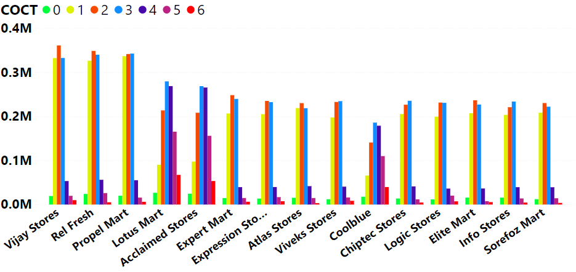
Customer wise Analysis:
Avg. COCT
Insights:
Average Customer Order Cycle Time (COCT) is 2.24.
Average Delivery Delayed from promised date is 0.42.
Your maximum COCT is 6.
Total Delivered Quantity: 12.97M.
Feedback:
So, basically you need to improve your COCT, so that it can give you better satisfaction to your customers.
2.42
Avg. Delay
0.42
COCT
0
1
2
3
4
5
6
Delivered Quantity
255.66k
3.10M
3.70M
3.82M
1.23M
622.5k
232.3k
COCT by Customers

Slide 11

- by Dibyendu Biswas

